Slide 1
Solar Heat – a team player for decarbonising District heating Bärbel Epp IEA SHC Task 68 - Efficient Solar District Heating Systems https://task68.iea-shc.org/
EuroHeat & Power Congress Torino 2023

Slide 2
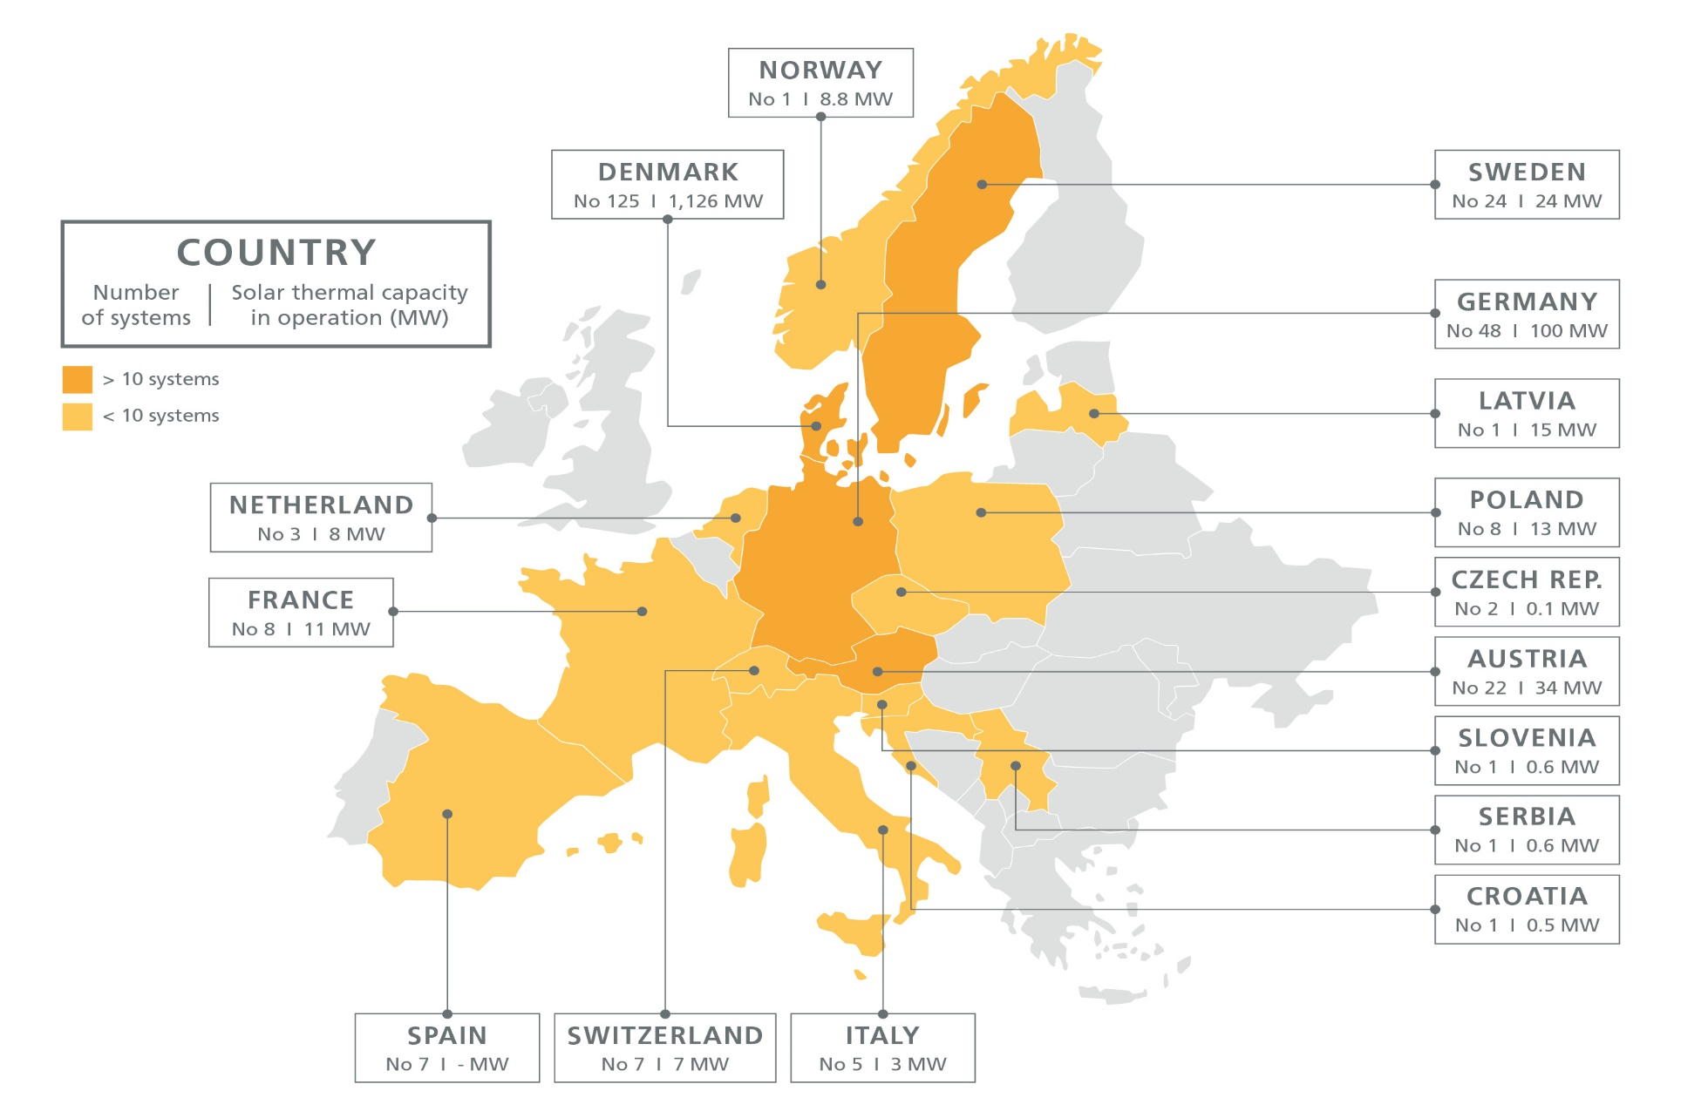
264 towns and cities in Europe use solar heat
Chart: IEA SHC Task 68
Source: IEA SHC Solar Heat Worldwide Report Ed. 2022 / own research

Slide 3
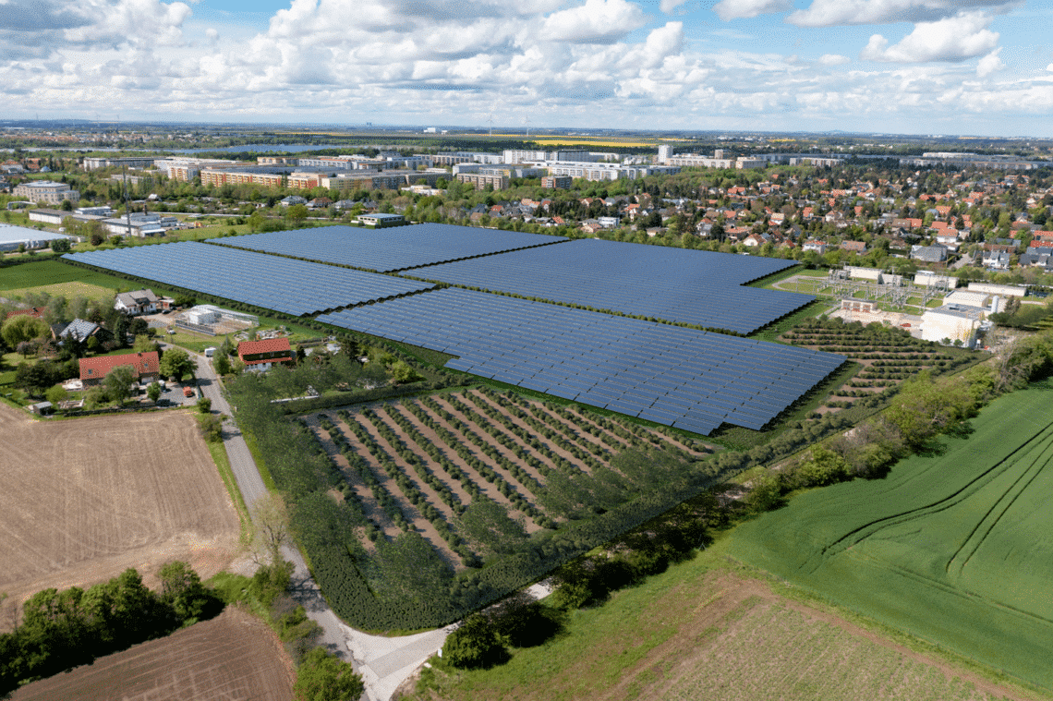
Multi-MW solar district heating plants on the rise across Europe
37 MW collector field under construction in Groningen, Netherlands. 30 years solar heat delivery contract with utility company Warmtestad. (25 GWh per year)
The municipal utility in Leipzig, Germany, placed the order for a 41 MW collector field in April 2023 (26 GWh per year)
Financing is secured for a 41 MW collector field in Pristina, Kosovo, planned by the local utility Termokos. (43 GWh per year)
Photo: Ritter Solar XL

Slide 4
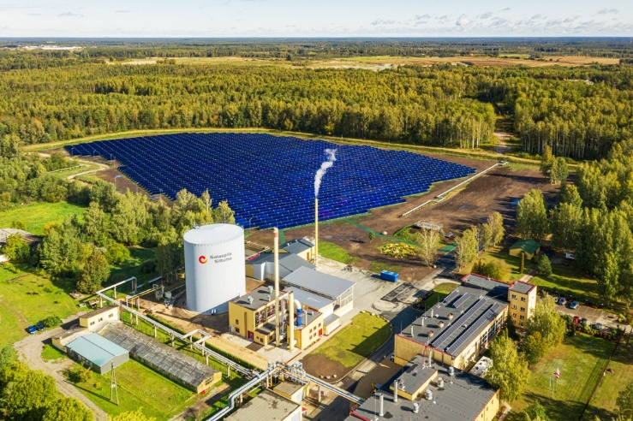
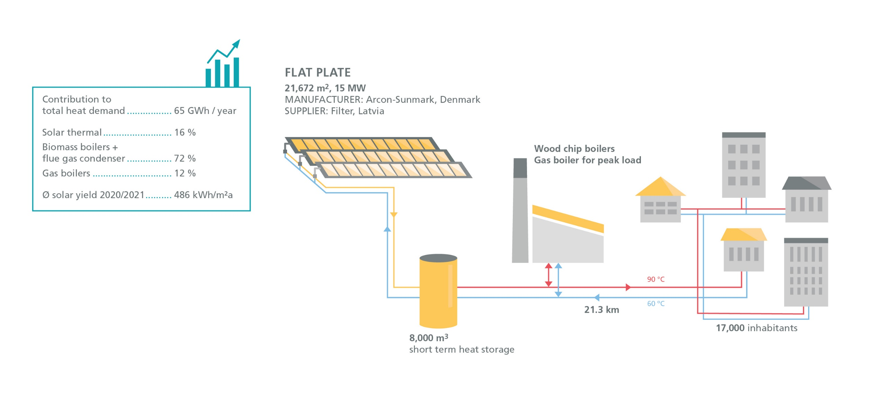
Salaspils, Latvia: 90 % renewable district heat since 2019
Photo: Salaspils Siltums

Slide 5
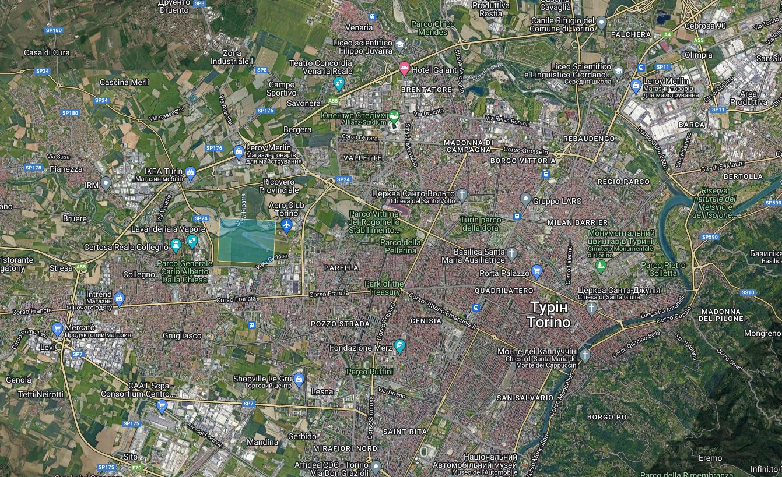
There is space for solar heat even in larger cities
3 to 4 m² pro kilowatt solar heat capacity
Site | Turin/Torino, Italy
Inhabitants | 847,000
Heat demand in heating grid | 1,815 GWh/a
Solar irradiation | 1,476 kWh/m2a
Land size of solar field | 129.7 hectares
Capacity of solar field | 401 MW
Solar share | 20 %
Source: https://www.absolicon.com/fs/

Slide 6
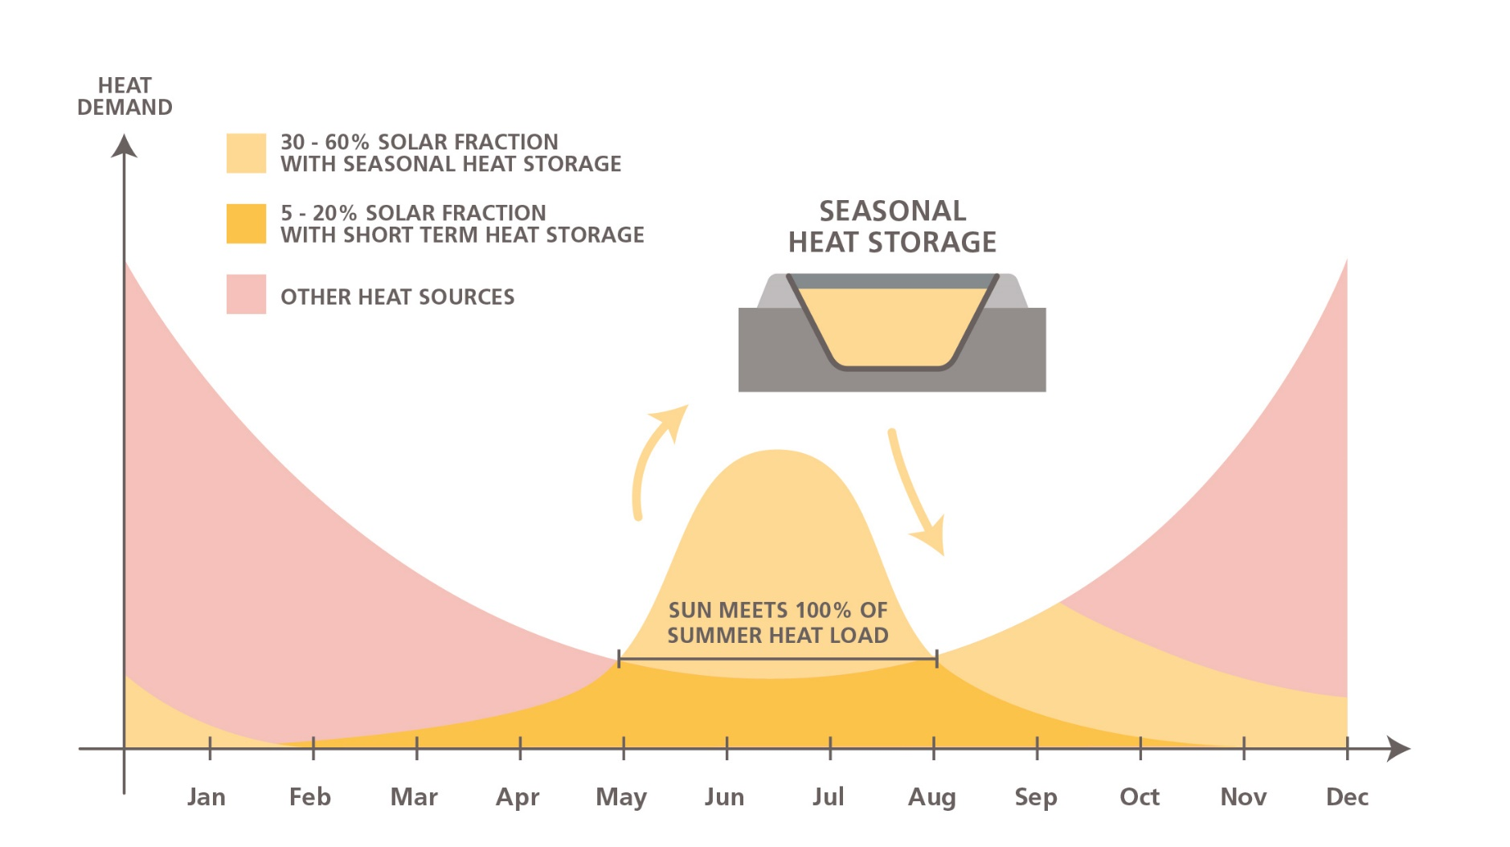
Storing solar energy in summer for heating in winter
A pit heat storage tank with more than 50,000 m³ loses 10 to 20 % of the stored energy over the year. The losses depend significantly on the size of the cover.
Chart: IEA SHC Task 55

Slide 7
Construction of a pit heat storage
Site | Meldorf, Germany
Storage volume | 45,000 m³
Application | Storing waste heat from printing press
Supply | Space heating of public offices and swimming pool in winter
Photo: Bärbel Epp / Solmax

Slide 8
Big Solar Pristina replaced coal-based electric heating
Site | Pristina, Kosovo
New district heat consumers | 38,000
Annual solar share | 12 %
Capacity of solar field | 41 MW
Seasonal storage | 408,000 m³
Investment costs including extension of DH grid | EUR 80 million
Estimate start of construction | End of 2024
1.6 km pipeline between storage and CHP
4.2 km pipeline between solar field and the city
Graphic: CES clean energy solutions

Slide 9
Big Solar Pristina: absorption heat pumps are key
The absorption heat pumps heat up the water from the seasonal storage tank, if it does not meet the demand of the supply line for the heating network.

Slide 10
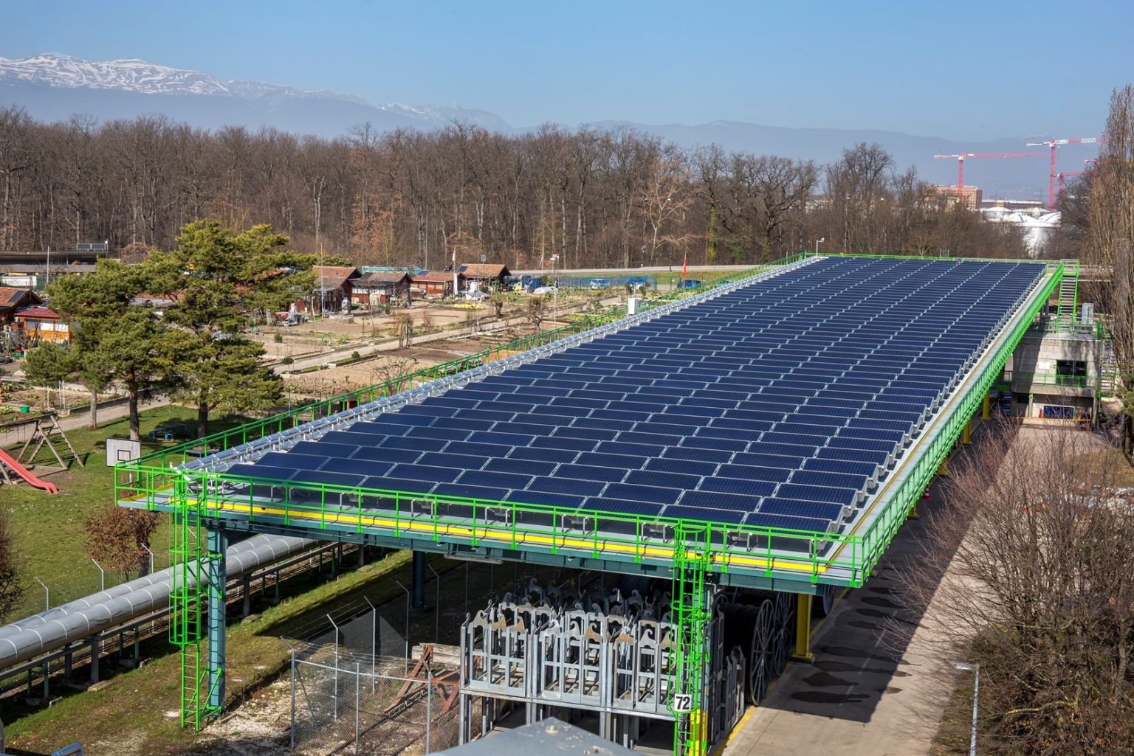
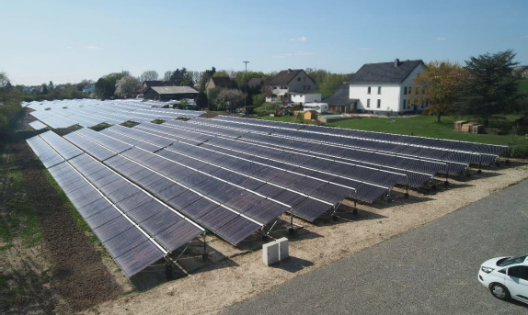
Each temperature level has a suitable collector type
Photo: TVP Solar
Photo: Viessmann
Special high-vacuum flat-plate collectors supplying heat to the heat network in Geneva, Switzerland, at a temperature of 85 °C, even in winter.
By adjusting the speed of the pumps in the solar circuit, this vacuum tube collector field delivers the required temperature of 90 °C constantly.

Slide 11
Each temperature level has a suitable collector type
Photo: Heliac
Photo: Aalborg CSP
Concentrating collectors (Point Focus Fresnel) deliver heat at around 160 °C in Hørsholm, Denmark
Combination of flat plate collectors (up to 70 °C) and parabolic trough collectors (up to 95 °C) in Taars, Denmark

Slide 12
Summary: Solar heat is a team player
Together with biomass boilers → to form a 100 % renewable supply
Together with seasonal storages → to form a flexible and efficient energy management system including power to heat
Together with heat pumps → to form a decarbonization strategy even for district heating grids with higher temperatures above 100 °C

Slide 13
Where can you get further technical advice?
Research and engineering services:
planenergi.eu/ in Denmark
www.best-research.eu in Austria
IEA SHC Task 68
task68.iea-shc.org/
www.solites.de/en/ in Germany
www.aee-intec.at/ in Austria

Slide 14
Where can you get further technical advice?
Technology and turnkey suppliers:
Aalborg CSP, Denmark: https://www.aalborgcsp.com/
Absolicon, Sweden: https://www.absolicon.com/
Greenonetec, Austria: https://www.greenonetec.com/
Heliac, Denmark: https://www.heliac.dk/
New Heat, France: https://newheat.com/en/
Ritter XL Solar, Germany: https://www.ritter-xl-solar.de/
Savosolar, Finland: https://savosolar.com/
Solarlite CSP Technology, Germany: https://www.solarlite.de/
Solid Solar Energy Systems, Austria: https://www.solid.at/de/home.html
TVP Solar, Switzerland: https://www.tvpsolar.com/
Viessmann, Germany: https://www.viessmann.de/
Source: Fotolia_69214426_M

Slide 15
Thanks for your attention! IEA SHC Task 68: https://task68.iea-shc.org/
Speaker: Bärbel Epp, epp@solrico.com

